Slide 1
UniTesK Test Suite Architecture
Igor Bourdonov Alexander Kossatchev Victor Kuliamin Alexander Petrenko
Notes:
This presentation is concerned with UniTesK test development method and the architecture of test suite proposed by it.
UniTesK stays for Unified Testing Kit. The method is intended for specification based test development for general purpose software. It is developed by RedVerst group of ISP RAS.

Slide 2
Origin of UniTesK Method
1994 – 1996 ISP RAS – Nortel Networks contract on functional test suite development for Switch Operating System kernel
Few hundreds of bugs found in the OS kernel, which had been 10 years in use
1996 KVEST technology developed About 600K lines of Nortel code tested in 1994 – 2000
Notes:
The method originates in the project carried out by RedVerst group for Nortel Networks. In 1994 Nortel Networks planned to change the model of mainstream switch and to port all the software to the new configuration. They tried to rewrite only the kernel of switch operating system without any changes in application layer. For this purpose they need thoroughly developed regression test suite for the kernel.
RedVerst group has developed formal specifications of the kernel, the method for automated functional test development based on specifications. Although the resulting test suite is not intended for testing of the switch operating system version already existing at that moment, it was used so and discovered about a few hundreds of inconsistencies. About twenty of them could cause cold restart of the system being in use for 10 years.

Slide 3
Functional Testing
UniTesK method deals with functional testing
Requirements
Formal Specifications
Tests
To automate testing we provide a formal representation of requirements
Notes:
UniTesK method deals with functional testing. Functional testing can be performed if the requirements on the behaviour of the target system are formulated. To make automated functional testing possible we should provide some representation of requirement that can be processed by computer. This representation is formal specifications.
What specifications can be used in industrial testing and we can use them?

Slide 4
Engineering problems
Arise when functional testing is used in modern industrial processes
How to simplify transformation of requirements into formal specifications?
How to automate specification based test development?
How to decouple tests and implementation?
It helps to develop tests earlier
It makes specifications and tests reusable
How to measure test quality without implementation?
Notes:
To answer this question, let us view at the problems arising when we try to introduce specification based testing in the industry.
The first problem is how to make transformation of requirements into specifications. It concerns not only the hardship of specification development in the industrial context, but also such tasks as requirements traceability on all the phases of software lifecycle.
Another problem is how to decouple specifications and tests on one side and target system implementation on the other side. This is important, because helps to develop tests in parallel with implementation, thereby decreasing the total time of product development, and gives a basis for regression testing or other kinds of specifications and tests reuse.
To make possible test development separated from implementation we should also provide some implementation-independent metrics of test quality.

Slide 5
Specification Kinds
Constraints State based data type constraints, pre- and postconditions of operations
Executable Imperative state based
Algebraic Action based axioms
Which kind of specifications is more suitable for industrial testing?
Notes:
We considered different kinds of specifications: executable, constraint, and algebraic as candidates to be a base specification method.

Slide 6
Results of Comparison
Constraint specifications seems to be more suitable
Notes:
After comparison of all specification kinds using several criteria in the context of industrial testing, constraint specifications seem to be the most appropriate.

Slide 7
Specification Notation
Specification language
Suitable for capture abstract properties
Has formal semantics
Requires complex mediator layer for implementation
Requires special education, mastering is enduring
Extension of programming language
Abstract concepts can be added by libraries
Ambiguous parts of language can be excluded
Complex mediators are not required
Mastering can be made more effective
Notes:
Another question is what specification notation to use.
Two possible answers are
Classic specification language, like VDM, RSL, Z, Larch, and so on.
Such languages are powerful and at the same time easy to use to express abstract constraints and properties.
They have completely defined semantics.
But using such a language we need to build a complex mediator layer binding specifications with target system. Development of this layer is very hard, requires special skills, and forces the developer to think in two different language paradigms simultaneously. It should solve such problems, as, for example, modelling pointers in specification language.
Specification languages can hardly be adopted by the industry.
Our experience of work with Nortel engineers shows that they do not like to master a language that does not add a value to their CV.
On the other side, such languages often require special mathematic education, which many software engineers do not have. And mastering the technology based on specification language usually requires a lot of time.
We can use also specification extensions of widely used programming languages.
Although programming language is not so suitable for abstract properties expression, it can be extended by libraries implementing appropriate abstractions.
Sometimes programming languages have ambiguities in their semantics. We should avoid using ambiguous parts of language in specifications.
Complex mediator layer between specifications and implementation is not required in this case.
Extension of widely programming language can be much easily adopted in the industry, because many engineers are already familiar with the base language, and mastering the corresponding technology do not require long hard work. Moreover, the mastering process can be organized in such a way that even after short time the developer can use the technology to obtain valuable results.
So, specification extension of programming language looks much more attractive decision.

Slide 8
Decomposition of Testing Task
From specification we can generate oracle
The entire test is a test sequence intended to achieve some coverage
Test sequence construction
Oracle
Target system
Notes:
Let us proceed to the architecture of UniTesK test suite.
The general idea of UniTesK test architecture is simple: we analyse the tasks to be solved by test system able to be used in the industry, define possible decomposition of test suite into a number of components, and then, analyse these components for the purpose of lessening the human work needed to obtain them. Some of the components have no target system specific and can be pre-built in the test development solution. Others require some data on the system under test, and so should be generated for each target system, maybe using some manually added information.
Since we have formal representation of requirements as formal specifications, we can transform them automatically into oracles. An oracle of an operation is a component, which checks the precondition of the operation, then calls it if the precondition holds, and then checks the results with the help of postcondition constraint. UniTesK approach use such oracles, which can be called “universal” in contrast to usually used in the industry input/output oracle that can work only for prescribe vectors of target operation arguments.
Then, we build the entire test as execution of test sequence, a sequence of target operations calls that is intended to achieve some coverage, called the target coverage of the test.
The corresponding decomposition of test suite is obvious — the component generating test sequence the oracle of the next target operation, and the oracle performs the invocation of the target operation and checks the correctness of its behaviour.

Slide 9
Mediators
Mediator binds specification with implementation, making possible their separation
More abstract specifications become possible
Implementation may have different interface
Support for regression testing
Support for other kinds of specification reuse
Oracle
Test sequence construction
Oracle
Mediator
Target system
Target system
Notes:
As we see, UniTesK approach tries to separate specifications from any specific implementation of the target system. But to make possible testing of the second with the help of the first, some binding should be defined between them. This role is performed by mediator components.
In the test suite mediator is called directly form an oracle and transforms the model arguments into the corresponding implementation ones. After the target operation returns the control, it transforms its results into model representation.
Mediators make possible for specifications and implementation to have different structure of data and interfaces. Specifications become much more abstract and closer to requirements. Furthermore, tests constructed on the based of such specifications can be easily used for regression testing or reused in other projects to test components having the same functionality.

Slide 10
Test Sequence Construction
Problems of coverage driven testing using automaton model
Implicit specifications cannot be resolved
Nondeterminism
Huge numbers of states and transitions
Notes:
How is test sequence construction organized in UniTesK?
Let us imagine an automaton model of the target system, where states correspond to all possible states of the system and transitions correspond to invocations of target operations with all possible argument vectors. A behaviour oriented coverage criterion defines some coverage of transitions of this automaton.
To achieve the necessary percent of this coverage we can try to construct a test sequence on the base of the automaton structure, but there are several serious obstacles.
Specifications are represented as constraints. They define the automaton in an implicit way that can hardly be made explicit for real-life software.
Implicit specifications also often assume serious nondeterminism of a model.
Even in the case when we can solve implicit constraints the size of the automaton is huge. To model adequately real life software it should usually contain myriads of states and transitions.

Slide 11
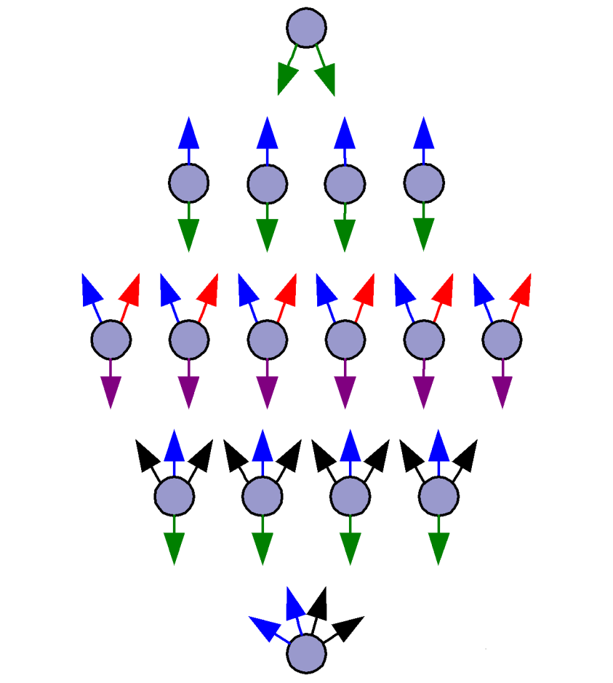
Automata Factorization and Implicit Description
Notes:
UniTesK approach proposes the following way to cope with the problem.
Test developer determines a factorization of huge automaton by uniting states and transitions that are equivalent for the target coverage criterion. The resulting model is finite automaton, or finite state machine (FSM), having much less states and transitions. But traversal of the resulting automaton gives us the complete coverage according to the target coverage criterion.
The resulting automaton serves as a source for test sequence construction and is called testing model.
Another significant decrease of complexity can be obtained by use of implicit FSM description. This description contains only list of states and possible input symbols for each state. Such a description can be easily constructed, for example, from constraint specifications and enumeration of states. Factorization of implicitly defined automata is also easier.

Slide 12
Test Sequence Construction Machinery
Test sequence is generated as a traversal of FSM model of target system
Test Engine encapsulates FSM traversal algorithm
Test Sequence Iterator encapsulates description of FSM model
Test Engine
Test sequence construction
Oracle
Test Sequence Iterator
Target system
Oracle
Notes:
UniTesK test sequence generation mechanism is based on traversal of testing model.
It is possible to separate the algorithm used to construct a traversal of FSM from description of FSM itself. The first is encapsulated in test engine component, and the second — in test sequence iterator component.

Slide 13
Test Sequence Iterator Details
Test Engine
Test sequence construction
Input Symbol Iteration
Test Sequence Iterator
Target Coverage Filtering
Oracle
State Converter
Input Symbol Iteration
Caller
Target system
Iterators
Iterators
Oracle
Notes:
The details of Test Sequence Iterator functions are as follows.
It contains definition of state equivalence classes that helps to determine the hyperstate or generalized state of testing model on the base of the model state of the target system.
For each generalized state test sequence iterator should provide iteration of allowable input symbols.
At last, test sequence iterator enables the test engine to apply the next input symbol.
The iteration of allowable inputs is organized as iteration of some set of input symbols (for example, operations under test and iteration of arguments vectors for each operation) with the following filtering of symbols obtained with the help of target coverage tracker generated on the base of coverage description. A tracker throws away the symbols that add nothing to already obtained coverage.
Such approach allows not to calculate the precise data corresponding to different input symbols, but to write a relatively simple iterator of a set including the necessary input symbols. The first trial may do not obtain the sufficient level of test coverage, but we can then improve the iterator to obtain more exhaustive test.

Slide 14
UniTesK Tools and Applications
CTesK – C implementation
Microsoft IPv6 implementation
J@T – Java implementation
Partially tested by itself
Parallel debugger API for mpC
VDM++TesK
Notes:
UniTesK method serves as a base for several language-specific technologies of test development.
CTesK. UniTesK implementation for С language. The tool was developed in 2001.
Successfully used for testing Microsoft IPv6 implementation.
J@T. The tool implementing UniTesK method for Java software. Was developed in 2000-2002.
Several parts of J@T implementation were tested with the help of J@T itself.
Debugger API for Multiprocessing extension of С language.
VDM++TesK.

Slide 15
References
A. K. Petrenko, I. B. Bourdonov, A. S. Kossatchev, V. V. Kuliamin. Experiences in using testing tools and technology in real-life applications. Proceedings of SETT’01, India, Pune, 2001
I. B. Bourdonov, A. S. Kossatchev, V. V. Kuliamin. Using Finite State Machines in Program Testing. "Programmirovanije", 2000, No. 2 (in Russian). Programming and Computer Software, Vol. 26, No. 2, 2000, pp. 61-73 (English version)
I. Bourdonov, A. Kossatchev, A. Petrenko, and D. Galter. KVEST: Automated Generation of Test Suites from Formal Specifications. Proceedings of World Congress of Formal Methods, Toulouse, France, LNCS, No. 1708, 1999, pp. 608-621
I. B. Bourdonov, A. S. Kossatchev, V. V. Kuliamin, A. V. Maximov. Testing Programs Modeled by Nondeterministic Finite State Machine. (see [5] white papers)
http://www.ispras.ru/~RedVerst/

Slide 16
Contact
Victor V. Kuliamin
E-mail: kuliamin@ispras.ru
109004, B. Communisticheskaya, 25
Moscow, Russia.
Web: http://www.ispras.ru/~RedVerst
Phone: 007-095-9125317 ext 4422
Fax: 007-095-9121524

Slide 17
Specification Kinds: Constraints
Have the structuring similar with implementation But have different form
Are easy to use in the industry
Are close to requirements in most cases Counterexample: memory management subsystem
Suitable for test coverage measurement
Can be directly used in conformance checking
Special constructs enabling reuse can be added
Notes:
Constraint specifications
Has the similar structuring with implementation. This fact makes their introduction into the industry not very hard, yet helps to stay much less coupled with implementation.
They are close to requirements. To formulate requirements in the form of constraint specifications is more easy in most cases.
This, on one side helps to handle problems of requirements traceability.
On the other side, it makes possible to construct requirements-based coverage criteria from the structure of constraints.
Unfortunately, not for all systems constraints can be developed separate from some implementation. Memory management systems can hardly be specified in complete, not closed to some implementation way with the help of constraints.
Can easily be transformed into oracles.
Additional constructs can make constraint specifications reusable.

Slide 18
Specification Kinds: Executable
Are very close to some implementation
Are easy to use in the industry
Can be used to produce prototypes
Are not close to requirements ( √¯ = e^{½ln} = lim(x_{n+1} = ½(x_{n} +x/x_{n})) )
Unsuitable for test coverage measurement
Can cause problems with conformance checking How to compare the results?
Are highly reusable
Notes:
Executable specifications are
Very close to some implementation. They actually provide an implementation of functionality described.
This means that they can be easily introduced in the industry
The extra advantage is that they can be used as prototypes
But they are not close to requirements, except for simple cases. For example, we can consider specifications of square root function. Executable specification can specify it as a sum of endless series, or a limit of iterative process, or as exp(ln/2). Any of these representations says nothing comprehensible about what we should obtain as a result.
So, they can hardly help in solving requirements traceability problems.
Another implication — they cannot be used as a source of test coverage metrics.
Executable specifications in some cases are hard for conformance checking. Obvious examples of such hardship are approximate calculations or nondeterministic result.
Executable specifications are highly reusable.

Slide 19
Specification Kinds: Algebraic
Are far from common implementations and have greatly different structure
Can hardly be introduced in the industry
Can be far from requirements or close to them for different kinds of systems
Can hardly be used for coverage measurement
Can be used for conformance checking But sharpen error localization problems
Reusability is a problem
Notes:
Algebraic specifications
Are far from almost any implementations, differ very much from commonly used in the industry languages and model.
So, they are separate from an implementation.
But, very hard to introduce into common development processes.
Are far from requirements for most kinds of systems. But, for some ones can be appropriate. Example: memory management subsystem.
Can hardly be used for definition of test coverage criteria.
Can be used for conformance checking, but sharpen the problem of error localization. While executable and constraint specification has high level structure similar with the implementation one and can easily point the operation where the failure occurred, although it can correspond to an error in one of the previously called operations, algebraic specifications cannot even say what operation call exposes the failure.
We do not know how to provide reusable algebraic specifications.

Slide 20
Test Engine Work Details
Test Engine
Test Sequence Iterator
State Converter
Input Symbol Iteration
Caller
Oracle
Notes:
Test Engine work in general is as follows.
It asks for the identifier of the current generalized state.
It asks for the next untested input symbol in this state.
If this state has untested input symbols, it applies the next one and returns at I.
If this state has no untested input symbols, it seeks for states that have
If there are no such states, the test is finished.
If there exist such a state, Test Engine used the information it storeв before to find a path to this state, executes this path, and returns to I.

