Slide 1
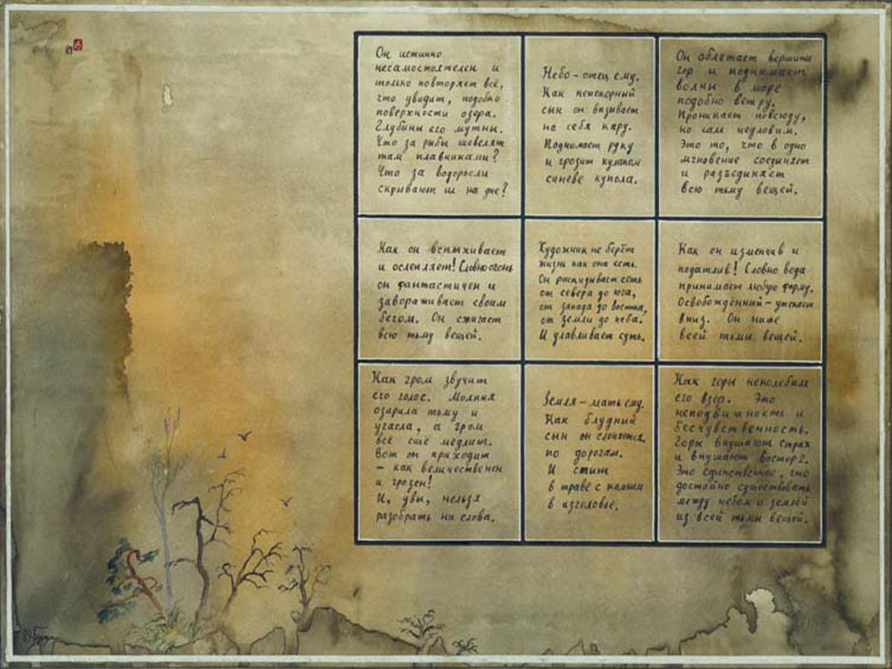
Igor Burdonov
Alexander Kossatchev
Building direct and back spanning trees by automata on a graph
The Institute for System Programming (ISP) of the Russian Academy of Sciences (RAS)

Slide 2
A task of graph exploration with a goal to uncover a structure of unknown graph by moving along its arcs can be met in many domains.
In this paper we regard as possible applications exploration of networks and exploration of Web-application structure.
In many cases such an exploration can be considered as being performed by agents working in graph vertices and sending each other messages along graph arcs.
I.Burdonov, A.Kossatchev. ISP RAS. Building direct and back spanning trees by automata on a graph
(45)

Slide 3
Graph exploration starts from some specified vertex, called root vertex.
Directed graph exploration isn’t a trivial task.
In the worst case it takes time of an order O(mn), where n — the number of graph vertices, m — the number of graph arcs.
This holds for various algorithms of graph exploration based on breadth-first or depth-first traversal.
1
2
3
n-1
1
2
3
…
n
n
n+1
…
m
I.Burdonov, A.Kossatchev. ISP RAS. Building direct and back spanning trees by automata on a graph
(45)

Slide 4
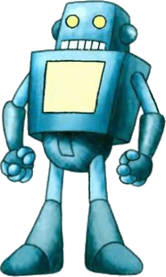
In 1966 M. O. Rabin posed the problem of directed graph exploration with a finite automaton.
Automaton on a graph is an analogue of the Turing machine — tape cells correspond to graph vertices, where the automaton can store some data, and moves along the tape correspond to moves along graph arcs.
…
…
…
…
…
…
…
…
…
…
I.Burdonov, A.Kossatchev. ISP RAS. Building direct and back spanning trees by automata on a graph
(45)

Slide 5
This system can be considered also as an aggregate of finite automatons located in graph vertices and interacting by message sending.
Each automaton changes its state according to the data stored in the corresponding vertex, and moves along graph arcs are replaced with messages sent along graph arcs.
...
...
...
...
...
...
...
...
...
...
I.Burdonov, A.Kossatchev. ISP RAS. Building direct and back spanning trees by automata on a graph
(45)

Slide 6
Messages are both input and output symbols of vertex automata.
If message size and number of each automaton states are bounded globally, all automata are just finite state machines.
Usual graph exploration corresponds to possibility for a single message to have a size linear on the number of vertices.
I.Burdonov, A.Kossatchev. ISP RAS. Building direct and back spanning trees by automata on a graph
(45)

Slide 7
If message size is bounded globally (finite state machines), the most efficient known algorithm of graph exploration with a single message has worst case working time O(nm+n²loglogn).
If the traversal is repeated by message interchange between automata located in vertices known after the first exploration worst case working time becomes O(nm+n²l(n)), where l(n) is the number of times logarithm calculation is repeated until 1≤log(log...(n)...)<2 holds.
I.Burdonov, A.Kossatchev. ISP RAS. Building direct and back spanning trees by automata on a graph
(45)

Slide 8
We consider parallel exploration of a graph — many messages can walk through its arcs in parallel.
Working time estimation in this case depends on the capacity of an arc k, which means the maximum number of messages that can be transmitted through a single arc simultaneously.
i ≤ k
3
2
1
…
I.Burdonov, A.Kossatchev. ISP RAS. Building direct and back spanning trees by automata on a graph
(45)

Slide 9
The suggested parallel graph exploration algorithm has worst case working time bound O(n/k+D), where
n is the number of vertices,
k is the capacity of an arc,
D is the graph diameter, the maximum length of simple path (non-self intersecting path).
6
7
6
8
5
9
D = 8
7
5
3
3
2
4
n = 10
4
2
1
1
I.Burdonov, A.Kossatchev. ISP RAS. Building direct and back spanning trees by automata on a graph
(45)

Slide 10
As a result the algorithm builds two spanning trees of the graph: the direct spanning tree, which has the root vertex as its tree root and is directed from the root, and the back spanning tree, directed to the root.
6
8
9
7
5
3
10
4
2
1
I.Burdonov, A.Kossatchev. ISP RAS. Building direct and back spanning trees by automata on a graph
(45)

Slide 11
The detailed description and proofs of all statements can be found in
“Parallel computations on graphs”. Programming and computer Software, 2015 г., No 1 (in print).].
I.Burdonov, A.Kossatchev. ISP RAS. Building direct and back spanning trees by automata on a graph
(45)

Slide 12
Sending a message an automaton working in some vertex should specify the arc, by which this message should be delivered.
We count that arcs starting in some vertex are numbered and an arc is specified by its number.
Let us denote s the maximum number of arcs starting in the same vertex of the graph, then m≤ns.
2
…
1
j ≤ s
I.Burdonov, A.Kossatchev. ISP RAS. Building direct and back spanning trees by automata on a graph
(45)

Slide 13
We also suppose that operation time of an automaton is negligibly small and the time of message transport through an arc is bounded by some constant.
We suggest the algorithm of spanning trees building with the following features:
vertex automaton memory is bounded by O(nDlog s),
message size is bounded by O(Dlog s),
arc capacity is k,
algorithm worst case working time is O(n/k + D).
I.Burdonov, A.Kossatchev. ISP RAS. Building direct and back spanning trees by automata on a graph
(45)

Slide 14
We call
direct arcs the arcs belonging to the direct spanning tree constructed by the algorithm,
chords — all other arcs,
back arcs — arcs belonging to the back spanning tree.
A back arc can be a chord or a direct arc.
Path vector is the list of arc numbers along the path.
Vertex vector is the vector of the simple path leading to this vertex from the root along the direct spanning tree.
The root has empty vertex vector ε.
The size of simple path vector or vector of a simple cycle is O(Dlogs).
A message in the algorithm below consists of a constant number of simple path vectors, or O(Dlogs) bits.
I.Burdonov, A.Kossatchev. ISP RAS. Building direct and back spanning trees by automata on a graph
(45)

Slide 15
The algorithm is partitioned in four parts.
The first part describes building of the back spanning tree.
The second part performs the check that back spanning tree is completely constructed.
The third part depicts classification of arcs starting in one vertex.
The fourth one describes maintenance of incoming back arc counters in vertices.
I.Burdonov, A.Kossatchev. ISP RAS. Building direct and back spanning trees by automata on a graph
(45)

Slide 16
The first part uses messages of four kinds: Start, Root search, Direct, and Back.
Start message is sent by the root automaton to automata of all other vertices, it contains the vertex vector and initiates vertex automaton operation, which is started by sending Root search messages.
6
8
9
7
5
3
10
4
2
1
I.Burdonov, A.Kossatchev. ISP RAS. Building direct and back spanning trees by automata on a graph
(45)

Slide 17
Root search messages are sent through all outgoing arcs in such a way that they pass some simple path to the root vertex and report the root automaton the vector of this simple path.
6
8
9
7
5
3
10
4
2
1
I.Burdonov, A.Kossatchev. ISP RAS. Building direct and back spanning trees by automata on a graph
(45)

Slide 18
Root search messages are sent through all outgoing arcs in such a way that they pass some simple path to the root vertex and report the root automaton the vector of this simple path.
6
8
9
7
5
3
10
4
2
1
I.Burdonov, A.Kossatchev. ISP RAS. Building direct and back spanning trees by automata on a graph
(45)

Slide 19
The first part uses messages of four kinds: Start, Root search, Direct, and Back.
Start message is sent by the root automaton to automata of all other vertices, it contains the vertex vector and initiates vertex automaton operation, which is started by sending Root search messages.
Root search messages are sent through all outgoing arcs in such a way that they pass some simple path to the root vertex and report the root automaton the vector of this simple path.
In response root vertex automaton sends Direct message, which reaches the Root search initiator and reports it the back simple path vector, computed by root search.
The initiator then sends Back message, which sets some tags along the back simple path.
I.Burdonov, A.Kossatchev. ISP RAS. Building direct and back spanning trees by automata on a graph
(45)

Slide 20
The second part has the task to determine that the back spanning tree is completely constructed.
It uses arc counting — when the arc counter in the root vertex becomes zero, the tree building is complete.
For each arc a→b the root automaton gets first the message from a, where “+1” is set for the arc a→b, and then it gets the message from b, where “-1” is set for a→b.
The second message comes from b later than messages from the same b, setting “+1” for all arcs starting in b.
For this goal the modified Root search and two additional message kinds — Finish and Minus — are used.
I.Burdonov, A.Kossatchev. ISP RAS. Building direct and back spanning trees by automata on a graph
(45)

Slide 21
Root search contains the number of arcs starting from its initiator.
When the root automaton gets Root search message, it adds this number to the global counter of outgoing arcs.
Finish message is sent from a vertex after getting Direct message.
After sending Finish message and setting back arc in the vertex, the Minus message is send.
The root automaton decreases its arc counter by 1 after getting Minus message.
I.Burdonov, A.Kossatchev. ISP RAS. Building direct and back spanning trees by automata on a graph
(45)

Slide 22
During the third part of the algorithm the outgoing arcs from each vertex are marked as either direct arcs or chords.
At first they all are considered as chords.
Then each arc, along which Direct message is sent, is marked as a direct arc.
I.Burdonov, A.Kossatchev. ISP RAS. Building direct and back spanning trees by automata on a graph
(45)

Slide 23
During the fourth part the incoming back arc counters are set in all vertices.
Two message kinds — Start counting and End counting — are used for that.
Start counting messages move from the root along direct arcs to all other vertices.
End counting message move from each vertex along back arcs and each vertex counts such messages created in the start vertices of back arcs ending in this vertex.
I.Burdonov, A.Kossatchev. ISP RAS. Building direct and back spanning trees by automata on a graph
(45)

Slide 24
At the end of algorithm work each vertex automaton stores type of each outgoing arc and the number of incoming back arcs.
These data can further be used for parallel computation of some functions of values stored in graph vertices.
I.Burdonov, A.Kossatchev. ISP RAS. Building direct and back spanning trees by automata on a graph
(45)

Slide 25
Igor Burdonov
Alexander Kossatchev
Victor Kuliamin
Parallel calculations by automata on direct and back spanning trees of a graph
The Institute for System Programming (ISP) of the Russian Academy of Sciences (RAS)

Slide 26
At the end of algorithm work each vertex automaton stores type of each outgoing arc and the number of incoming back arcs.
These data can further be used for parallel computation of some functions of values stored in graph vertices.
I.Burdonov, A.Kossatchev, V.Kuliamin. ISP RAS. Parallel calculations by automata on a graph
(45)

Slide 27
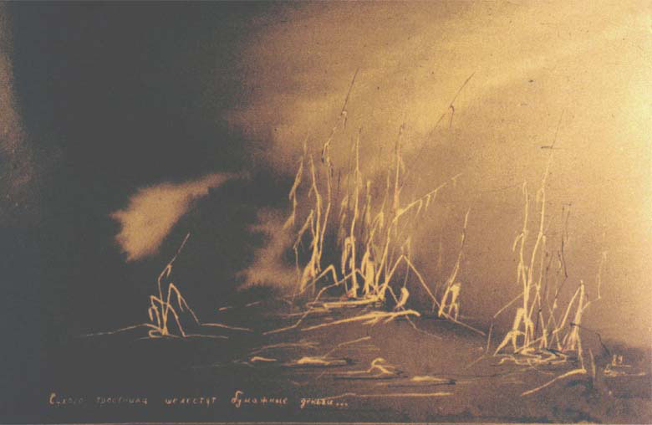
Thank you

